Slide 1
Chapter: 2
Management Theories
Classical Management Perspective
  Scientific Management
  Administrative Management
Behavioral Perspective
  Human Relations Movement
  The Hawthorne Studies
  Emergence of Organizational Behavior
  Behavioral Management Perspective Today
Management Theories
2 - <number>

Slide 2
Contd….
Quantitative Management Perspective
  Management Science
  Operation Management
  Quantitative Management Perspective Today
Integrative Perspectives for Manager
  System approach
  Contingency Approach
  An Integrating Framework
Contemporary Management Issues and Changes
Management Theories
2 - <number>

Slide 3
Theory
A theory is conceptual framework for organizing knowledge and providing a blueprint for action.
Management theories are used to build organizations and guide them towards their goals, are grounded in reality.
Understanding the historical context of management provides a sense of heritage and can help managers avoid the mistakes of others.
Management Theories
2 - <number>

Slide 4
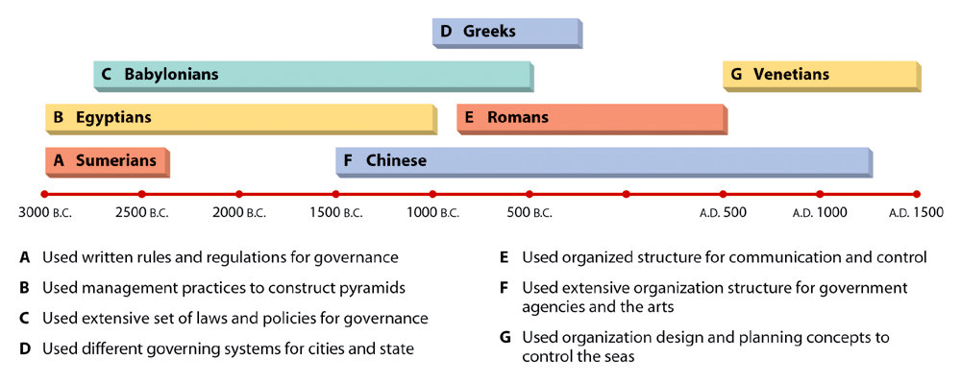
Figure 2.1: Management in Antiquity
Management Theories
2 - <number>

Slide 5
The Three Traditional Management Perspectives
The Classical Management Perspective:
  Ideas of the early 20th century theorists and managers converged with the emergence and evolution of large-scale business and management practice.
  This perspective actually includes two different viewpoints: scientific management and administrative management.
  Scientific Management Concerned with improving the performance of individual workers.
Frederick Taylor developed this system, which he believed would lead to a more efficient and productive work force.
Management Theories
2 - <number>

Slide 6
Steps in Scientific Management
Develop a science for each element of the job.
Scientifically select employees and then train them to do the job.
Supervise employees to make sure they follow prescribed methods.
Continue to plan the work, but use workers to get the work done. (see Figure 2.2)
Management Theories
2 - <number>

Slide 7
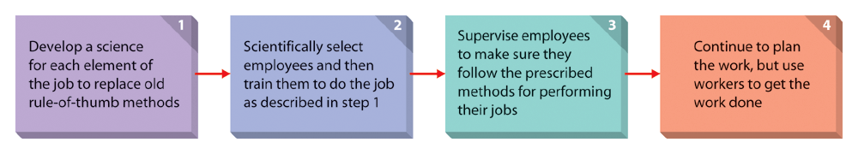
Figure 2.2: Steps in Scientific Management
Management Theories
2 - <number>

Slide 8
Administrative Management
Whereas scientific management deals with the jobs of individual employees, administrative management focuses on managing the total organization.
Administrative management laid the foundation for later development in management theory.
It is more appropriate for stable and simple organizations than for today’s dynamic and complex organizations.
(see Table 2.1)
Management Theories
2 - <number>

Slide 9
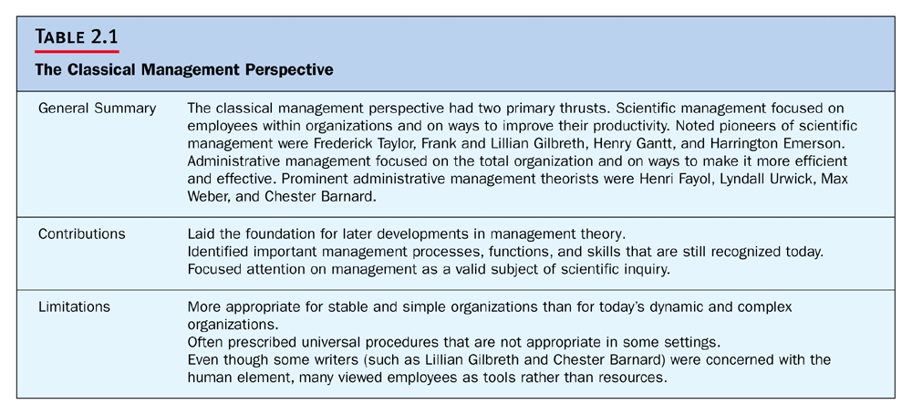
Management Theories
2 - <number>

Slide 10
The Behavioral Management Perspective
Unlike the classical management perspective, the behavioral management perspective placed more emphasis on individual attitudes and behaviors and on group processes and recognized the importance of behavioral processes in the work place.
The Human Relations Movement
Proposed that workers respond primarily to the social context of the workplace, including social conditioning, group norms, and interpersonal dynamics.
Management Theories
2 - <number>

Slide 11
Organizational Behavior
Human behavior in organizations is complex.
The field of organizational behavior draws from a broad, interdisciplinary base of psychology, sociology, anthropology, economics, and medicine.
There are two theories on how employees behave:
Management Theories
2 - <number>

Slide 12
Behavioral Theory on How Employees Behave Toward Work
Theory X Assumptions:
  Employees dislike work.
  Employees are irresponsible.
  Employees lack ambition.
  Employees resist change.
Theory Y Assumptions:
  Employees are willing to work.
  Employees are self directed.
  They accept responsibility.
  Employees are creative.
  They are self-controlled.
Management Theories
2 - <number>

Slide 13
The Quantitative Management Perspective
Management Science vs. Quantitative Management:
  Management Science focuses specifically on the development of mathematical models.
  Quantitative Management applies quantitative techniques to management.
  (see Table 2.4)
Management Theories
2 - <number>

Slide 14
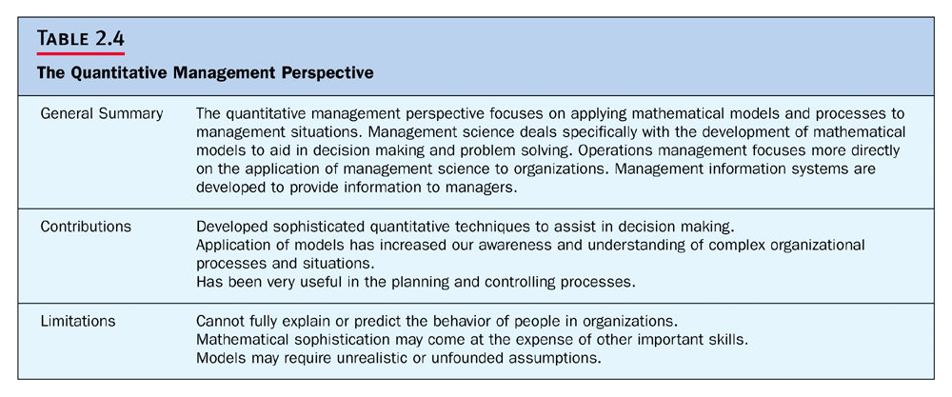
Management Theories
2 - <number>

Slide 15
The Systems Perspective of Organizations
Inputs from the
environment:
material inputs,
human inputs,
financial inputs, and
information inputs.
Transformation
Process:
technology,
operating systems,
administrative
systems, and
control systems
Outputs into
the environment:
products/services,
profits/losses,
employee behaviors,
and information
outputs
Feedback
Management Theories
2 - <number>

Slide 16
Concepts
Synergy: two or more subsystems working together may often be more successful then working alone.
Entropy: a normal process leading to system decline.
Universal perspective: tempting to identify one best way.
Contingency perspective: depending on elements in that situation.
Management Theories
2 - <number>

Slide 17
An Integrative Framework of
Management Perspectives
Systems Approach
Contingency Perspective
Recognition of internal interdependencies. Recognition of environmental influences.
Recognition of the situational nature of management. Response to particular characteristics of situation.
Classical
Management
Perspectives:
Methods for enhancing efficiency and facilitating planning, organizing, and controlling
Behavioral Management Perspectives:
Insights for motivating performance and understanding individual behavior, groups and teams, and leadership
Quantitative
Management
Perspective:
Techniques for improving decision making, resource allocation, and operations
Effective and efficient management
Management Theories
2 - <number>

Slide 18
Understanding a System
System: an interrelated set of elements functioning as a whole.
Types of Systems:
  Open System: an organizational system that interacts with its environment.
  Closed System: an organizational system that does not interact with its environment.
  Subsystem: a system within a broader system.
Management Theories
2 - <number>

Slide 19
Quantitative Management Perspective
Uses quantitative methods and models to manage decisions
Management Science
  Focuses on the development of mathematical models to assist with decisions
Operations Management
  Practical application of management science to efficiently manage the production and distribution of products and services
MIS
  to provide internal and external information
Management Theories
2 - <number>
Notes:
31

Slide 20
Quantitative Management Perspective
Contributions
  Developed quantitative techniques to assist in decision making.
  Application of models has increased awareness and understanding of complex processes and situations.
  Has been useful in the planning and controlling processes.
Limitations
  Cannot fully explain or predict behavior.
  Mathematical sophistication may come at the expense of other skills.
  Models may require unrealistic or unfounded assumptions.
Management Theories
2 - <number>
Notes:
32

Slide 21
Integrating Perspectives for Managers
A complete understanding of management requires an appreciation of, classical, behavioral, and quantitative approaches.
The systems and contingency perspectives can help managers integrate the three approaches and enlarge understanding of all three.
(see Figure 2.5)
Management Theories
2 - <number>

